Slide 1
American History Module 2
Talk | Title | Time Period | Date of Talk
8 | The early Republic | 1792-1800 | October 30th
9 | Jefferson’s America | 1800-1808 | November 6th
10 | War of 1812 and its impact | 1808-1815 | November 20th
11 | The Era of Good Feelings | 1816-1828 | December 4th
12 | Jacksonian ‘democracy’ | 1828-1836 | January 15h
13 | New Spain, Mexico and the Texas Republic | 1819-1846 | January 29th
14 | Manifest Destiny and the Mexican War | 1836 -1846 | February 5th
14 | California and the Gold Rush | 1700-1850 | February 19th

Slide 2
American History
1
Talk 13: New Spain, Mexico, the rise of Texas (1800-1846)

Slide 3
Overview
New Spain
Spanish Texas
Mexican Texas
Texas war of Independence
Texas Republic

Slide 4
New Spain

Slide 5
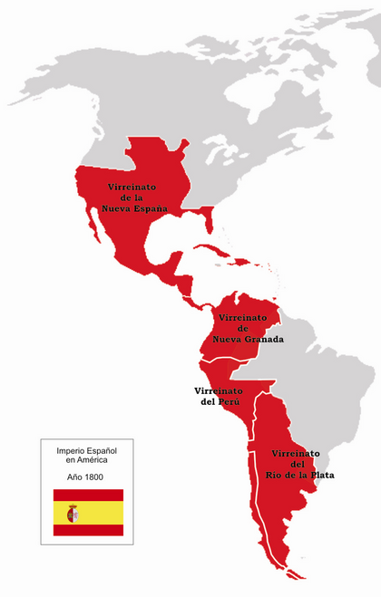
Spain and the America’s 1800
New
Spain

Slide 6
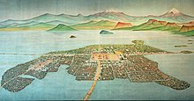
Large Indigenous population (20 million vs 3-5 million across entire North America)
Aztec Empire Central Mexico, 3,000,000 people, established 1350 by Mexica from north
King, bureaucracy, priesthood, army,
books, roads, slaves. Use of terror
and human sacrifice…fragile control
Capital Tenochtilan (pop 400,000),
Built on and around lakes, temples,
palaces, apartment blocks
Spanish demolished city in 1521 rebuilt
as European city…cathedrals on temples
Obliterate books, evidence of past

Slide 7
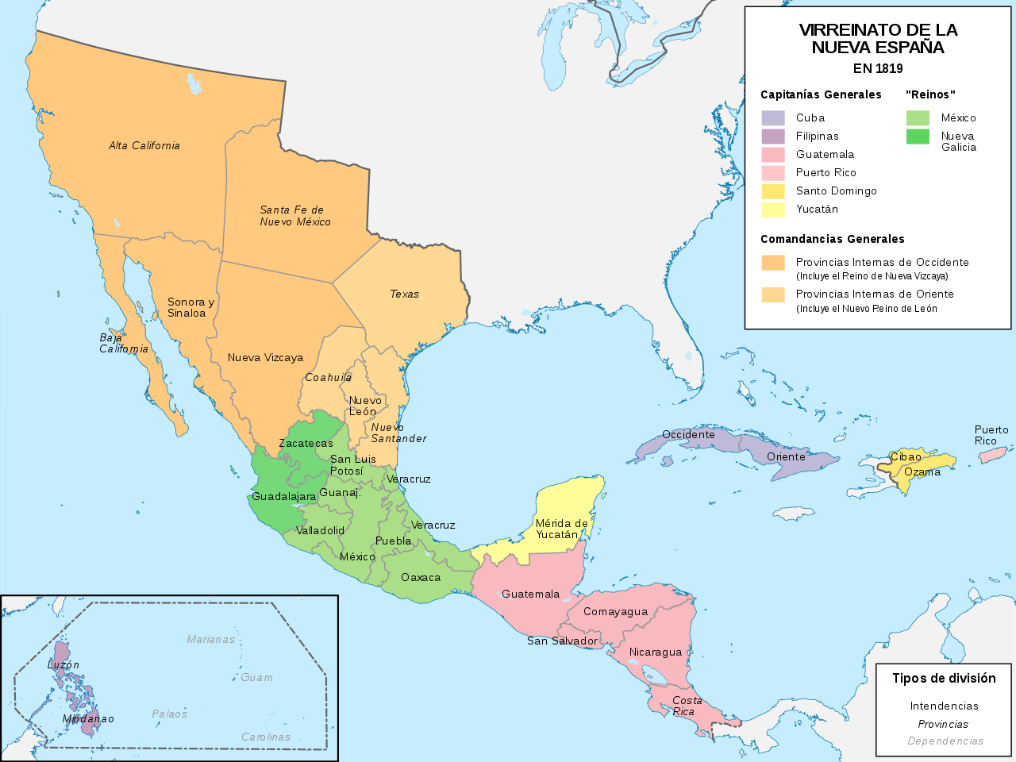
New Spain 1800
Indigenous population declined from 25 million to 2 million
Population 1819 5.5 million (same as USA )
20% European
25% Mestizo (mixed)
55% Indian
..Less than 10,000 Africans
Silver
95% Population in Central Mexico
…silver mines

Slide 8
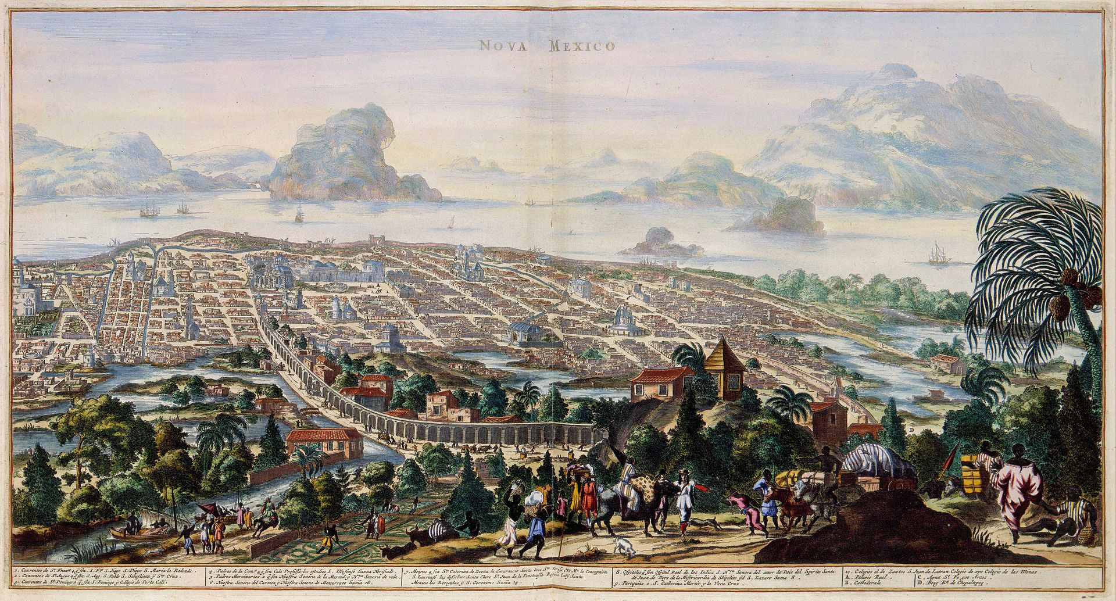
Mexico City 1690
Capital of New Spain
Population 250,000 1820
(New York 120,000)
Largest City in North
America till 1840’s

Slide 9
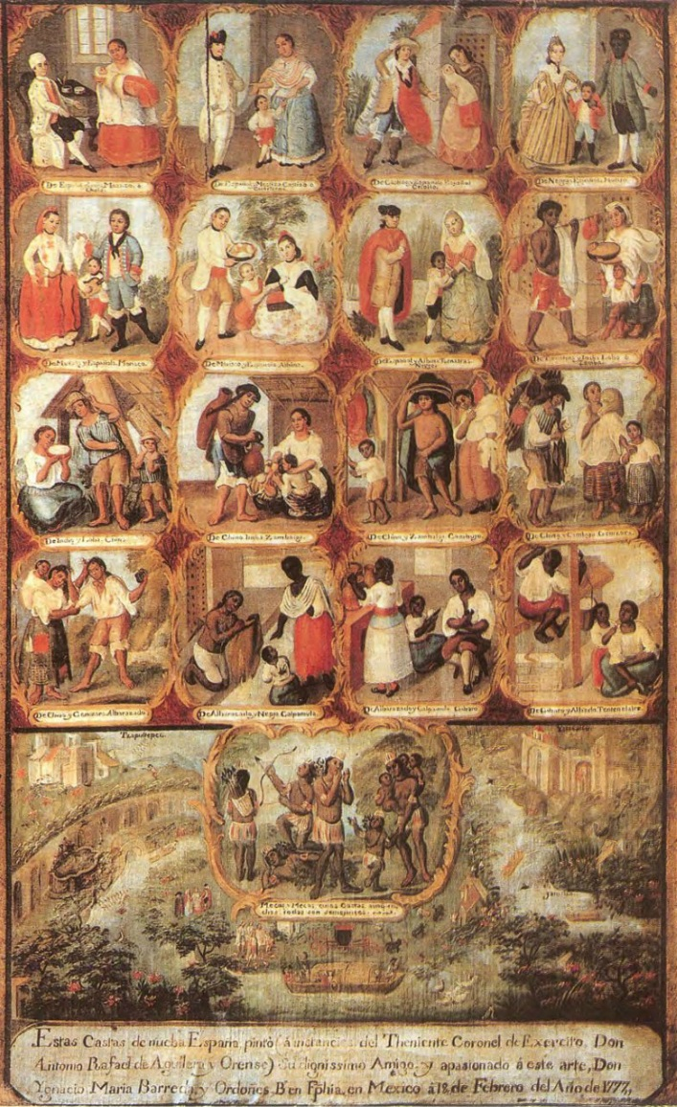
‘New Spain” a culture of 5 Classes
Top tier: 15,000 ‘Peninsularies” Spanish born
whites, Viceroys, senior officers, judges,
tax collectors
2nd tier: 1,000,000 ‘Creoles’, whites born in New Spain: Merchants, mine owners, land owners, junior officers, minor civil servants,
3rd tier: 1,500,000 White/Indian ‘Mestizos’
Soldiers, shop keepers, clerks,
4th: 3,500,000 Indians 3.500,000…free from taxation and slavery, menial jobs only. No vote
5^{th:} 15,000 Mulattos & blacks (mixed race black )
Slaves…menial jobs only..

Slide 10
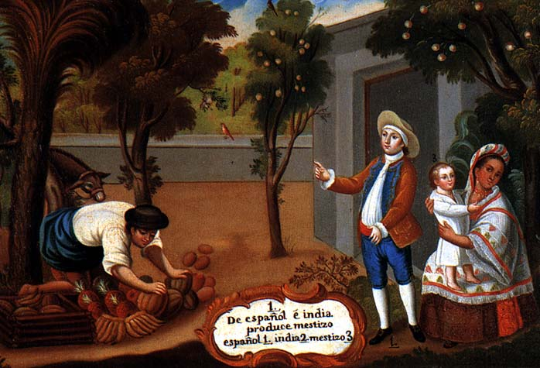
Coexistence of the unequal
Inter racial relations accepted as
normal…unlike US
Upward movement possible by
Purchase/ behaviour
Enforced by tradition and a strong
state….multiple cultures coexisting
but limited mixing ..not one society
…as in British Colonies

Slide 11
New Spain Governance Structure
King
Top Down hierarchical structure
Appointed officials
All appointees rotated (3-5 years) and subject to
30 day ‘review’ at end of office
Viceroy
Catholic church empowered to
And denounce rulers with impunity
Principales and wealthy Creoles
Vote for town government but no
Legislative resolving issues without resort to violence
Provinces
Provinces
Praesidios
(forts)
Towns
Military control remote areas (Texas, California)

Slide 12
Spanish Texas

Slide 13
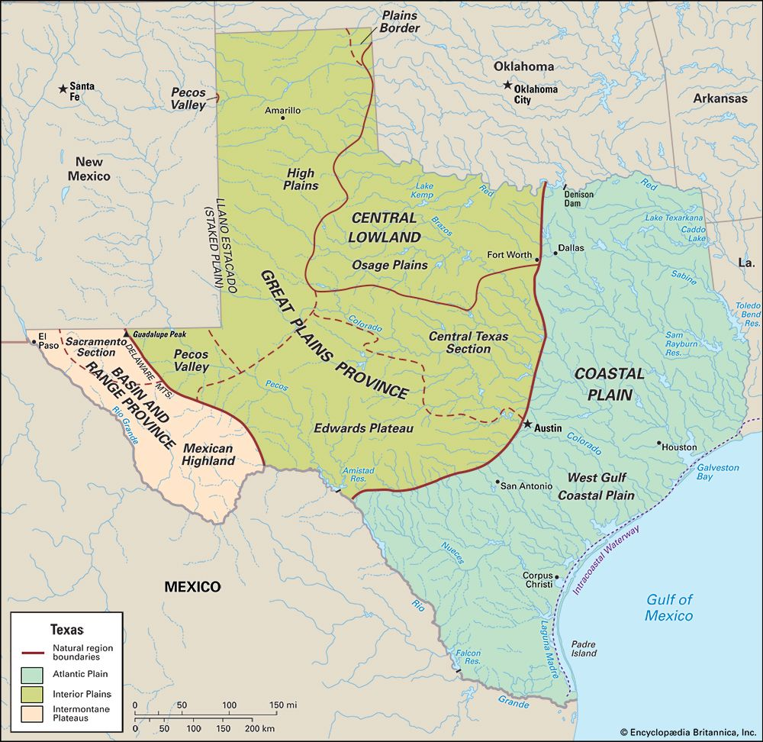
Texas: Hot,flat,and very big
Flat, not so
Hot, dry
(Buffalo)
Flat, dry,hot
Mesquite trees
Thick Pine forests, wet
Mountainous
High desert
Hills oak trees
Forest, swamp
Humid, bugs

Slide 14
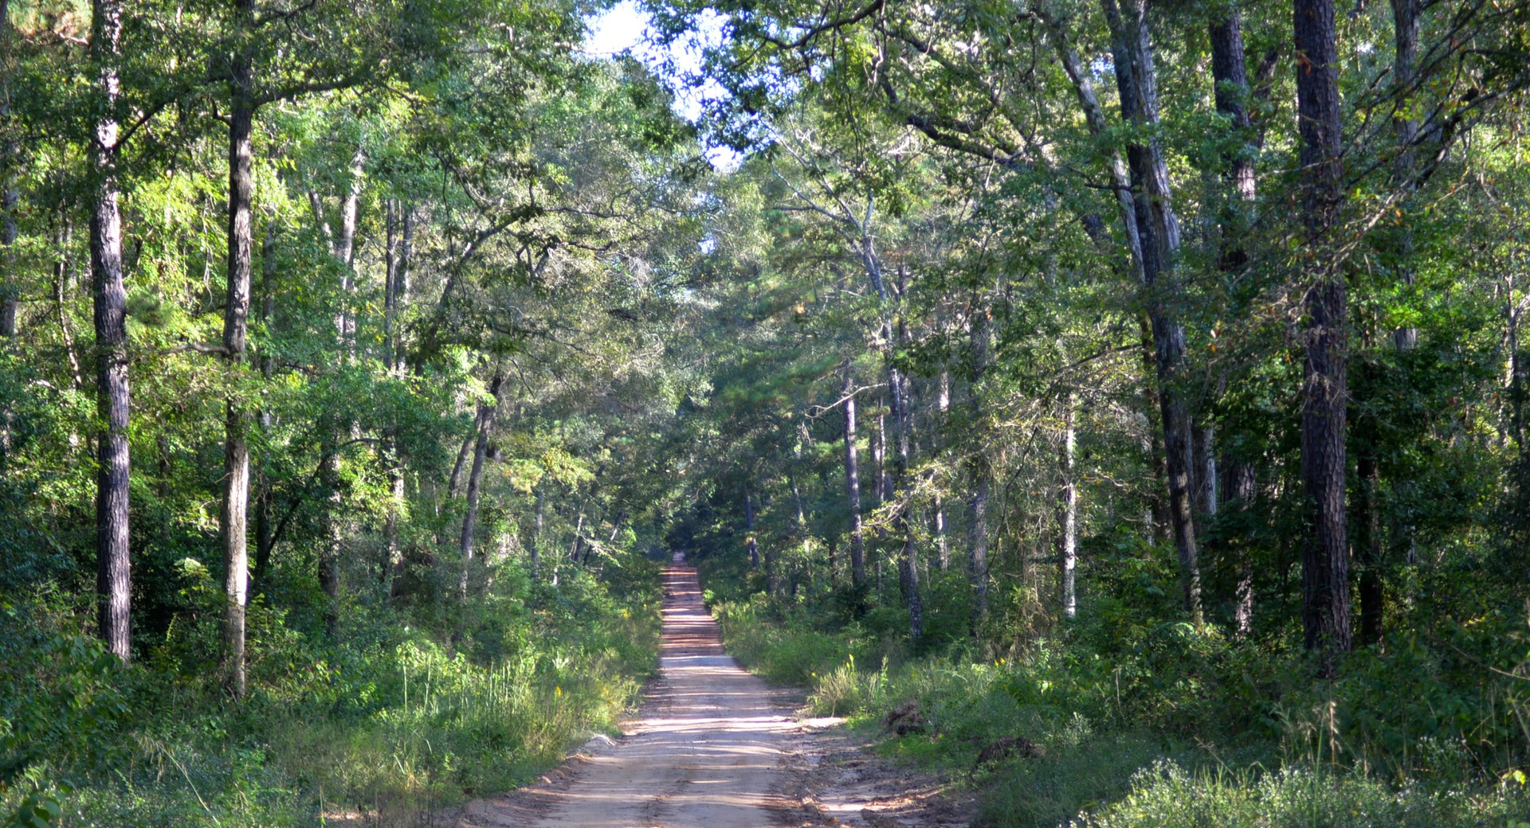
South/ East Texas Pine forest

Slide 15
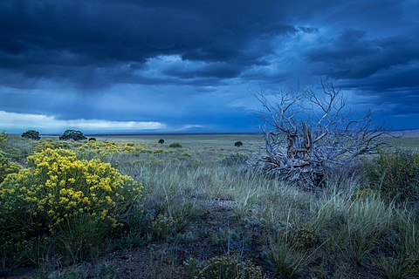
Great Plains

Slide 16
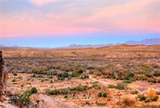
West Texas Desert

Slide 17
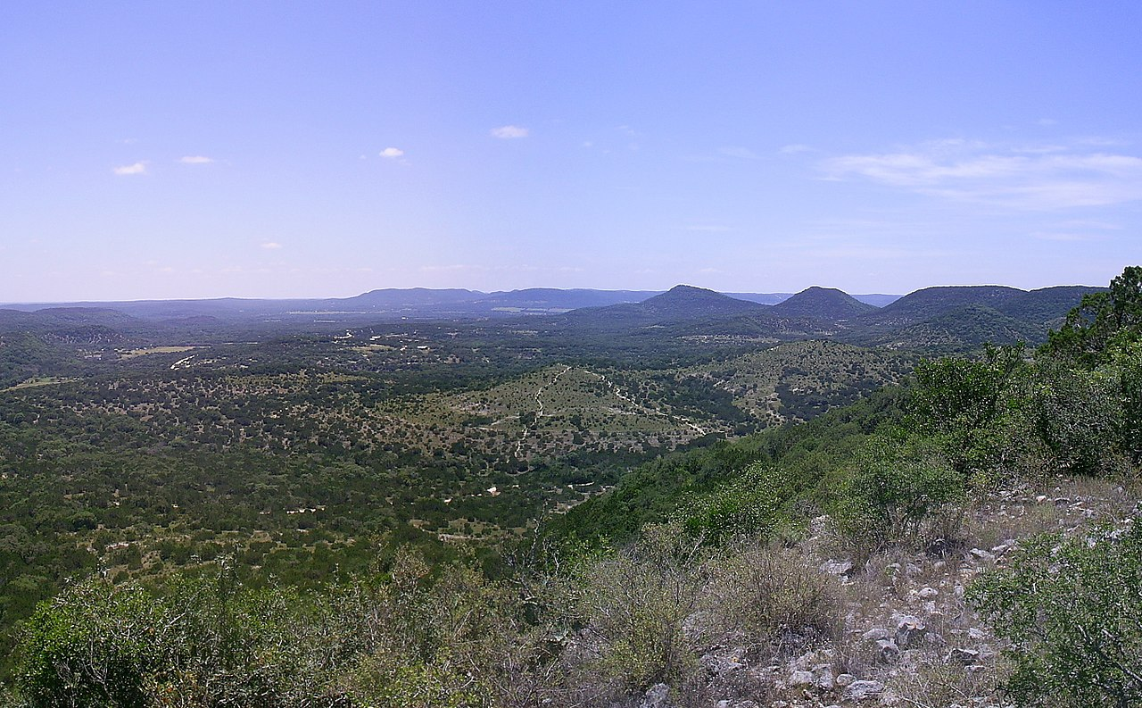
Hill country

Slide 18
Indigenous people of Texas
Coddas
Descendants of “Mississippi Mound culture
Sedentary farmers East Texas, villages of 1-2,000
Welcome missions…..Hispaniolised ,
Cohaliticans
Migrate annually from coast inland plains
Bands of up to 100
Attend Missions, become as Spanish
Apaches
Inhabit lower plains, hunt buffalo, plant crops, temporary housing
Multiple small groups of up to 20, each distinct, constant warfare
Become raiders and prey on sedentary Indians….and Spanish settlers.
Many other small tribes/bands. No government or common languages
Indigenous population dominated by newcomers…..the Comanche

Slide 19
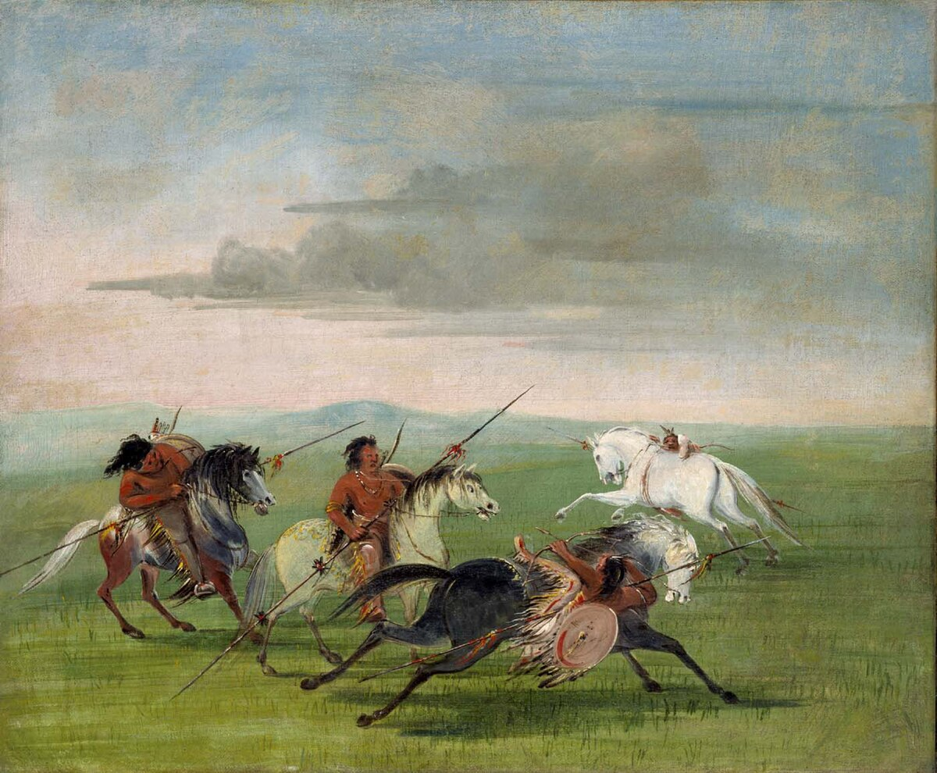
Comanche
Minor semi nomadic tribe of Great Plains till arrival of horse late 1600’s
Abandon agriculture become people
Of horse. Hunting and raiding culture
….population increase to 30,000
Invade Texas 1750’s
exterminate several indigenous tribes
drive Apache South
Every surviving tribe their enemy
force Spanish to seek peace
Central Texas becomes Comanche
Empire…..Comancheria

Slide 20
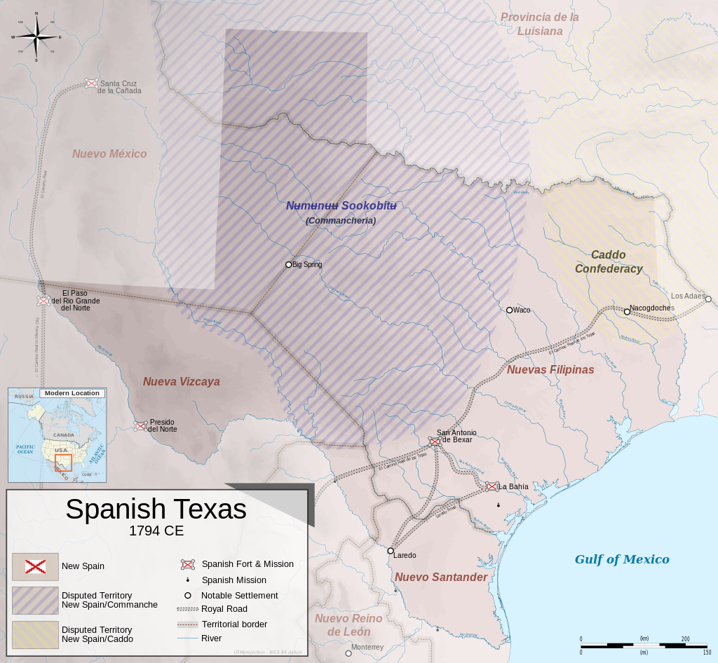
Spanish Tejas1800 : Considered a failed Colony
800 miles
Attempts to settle between
1600-1700 abandoned due to
Comanche & remoteness
Santé Fe
(3,000)
Scattered Praesidios,
Missions and villages annual tribute paid to Comanche.
Nacadoches
600 Tejanos
Comancheria
30,000
Coddas
Indians
1,000 miles
Trade banned with French & US
…all goods to from Mexico City
Apache
La Bahia
San Antonio2,000
1,000
“Tejas” considered useful only as buffer” to protect silver from Comanche, French & USA
Laredo
Cohalitican
Indians
1,000
Cattle only ‘industry’ 1800s

Slide 21
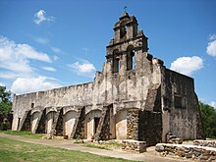
Missions
Purpose to convert Coddas
& Cohaliticans into Spanish subjects
: offer protection from Comanche
and Salvation …in exchange for
labour…voluntary. But could not
leave
Secularised 1780 by Spanish
Enlightenment Reforms
Converted Into army barracks/
warehouses
Coddas and Cohaliticans
Considered ‘Hispanicised’ ….released to farm, cowboys
for cattle industry.

Slide 22
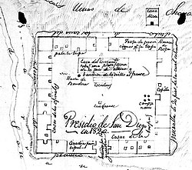
Praesidios
Forts built near Missions
50 – 100 soldiers
Centres of refuge, administration, prevent trade with USA
Occasional skirmishes with
Comanche…when tribute
Late. Or ignored

Slide 23
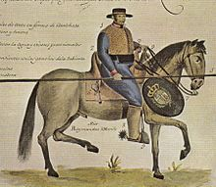
Spanish soldiers in Texas
1,000 strong army policing
800,000 square miles
Poorly paid, ill equipped (all
Supplies sent from Mexico City.
And frequently stolen`
Many criminals “sentenced”
to garrison Texas
Isolated, poorly equipped,
intermarry with local Indians,
survive by smuggling

Slide 24
Spanish change policy 1800’s
Texas becomes valuable to Spain
Cotton industry in US booming due to Cotton Gin.. East Texas perfect for cotton
France (then allied with Spain) sells Louisiana to USA
Spain consider Americans more aggressive as
Settlers move west, cross border to trade with Indians, steal horses and cattle
Viceroy in Mexico City decides Texas must be kept…attempts to increase population
Entice settlers from Mexico …no one interested
Develops plan to Secure 10,000 Catholic settlers from Spain and Swiss
………British sink Spanish fleet at Trafalgar 1805
Napoleon invades Spain 1808 …government in chaos…creoles revolt

Slide 25
Mexican War of Independence

Slide 26
Trigger: collapse of Spanish authority
France invades Spain 1808
Napoleon wants to destroy British ally Portugal
Spanish agree to let French army cross Spain
Napoleon decides to seize Spanish throne
Spanish people revolt vs French
Power vacuum
Viceroy seen as agent of ‘godless French’
Peninsularies overthrow Viceroy and seize power
Creoles revolt

Slide 27
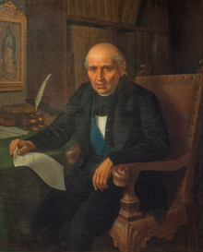
Miguel Hildalgo y Costilla (1753-1811)
Son of Basque mother, Spanish father
Born in Mexico…educated by Jesuits
Enlightenment inspired, large library
Prolific writer, admired by all classes
Enraged by condition of Indians
and power of Peninsularies…sees
Coup as opportunity to speak out

Slide 28
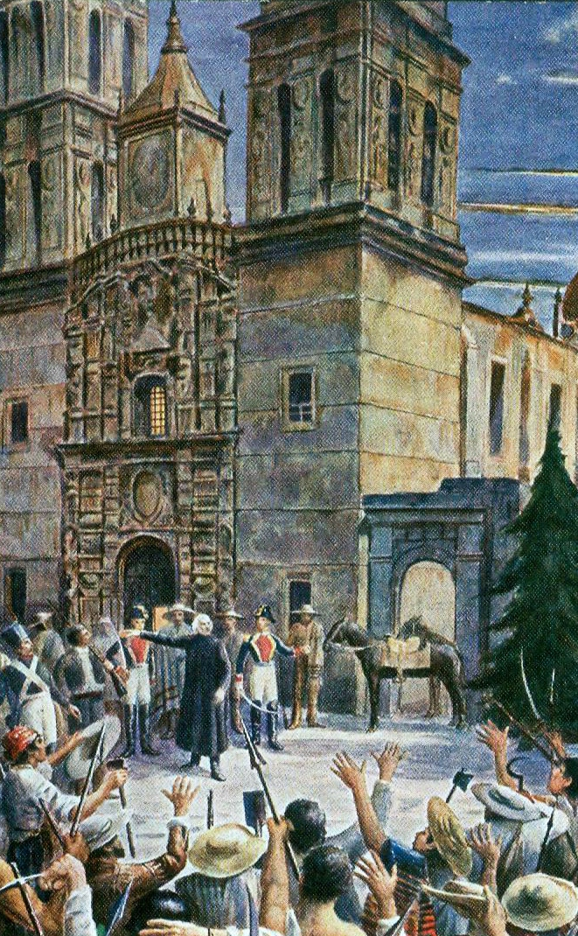
“Cry of Dolores” ….starts revolution
Hildalgo delivers “Cry of Dolores” to
‘protect the King” and unite Creoles,
Metizos and Indians to create ‘good
government” And unity
Followers grow... Asks 600 followers
to join him on march to Mexico City:
“Catholicism, King, Mexico”
No plan how new society will be
created… Indians see Hildalgo as
‘saviour’

Slide 29
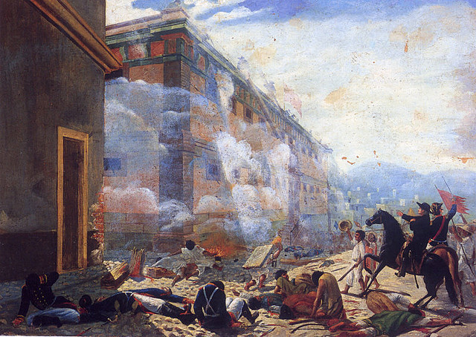
Hidalgo's army on the march
Followers grow to over 100,000
No structure, chain of command
Small Royalist army resists
and massacred…Hildalgo pleas
for peace ignored
Indians attack landowners
Killing families….army rampages way
towards Mexico city
Creole Officer (Bernado Guitterez sees chance to spread revolution in Tejas …goes to US for aid

Slide 30
Hidalgo Revolution (1810-1811)
Attack on Mexico City
Hidalgo's ‘army’ surrounds Mexico City….then retreats
Hidalgo see army out of control wants to stop bloodshed
Spanish army recovers and goes on attack
Hidalgo's army disintegrates…mass executions
Hidalgo captured, put on trial, stripped of priesthood …and shot
More revolts break out across New Spain

Slide 31
Revolution spreads to Texas: First “invasion”
Madison refuses direct help
Allows Gutierrez to recruit
American mercenaries
Battle of Medina 1812
Joint army of 1,400 Americans
and Tejanos ‘invade” Texas
declare Independence
from Spain
Spanish General Redondo
tricks rebels Into attack
Battle of Medina, rebels annihilated
Spanish Army execute 50% of Tejas population…..
Revolt ends in Texas

Slide 32
Mexican revolution 1811-1824
Warlords emerge across Mexico
600,000 dead, mass executions, total destruction of infrastructure
Indian leader Vincente Ramon Guerrero secures control of southern Mexico resistance
Spanish send sends its most trusted and brutal general, Augustin Irbide to destroy him

Slide 33
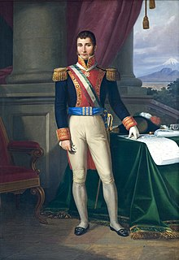
Mexican Independence
Creole who rises up ranks of Royalist army (cousin of Hildalgo) spurns offer to join revolt, captures Hildalgo and his him shot
Augustin Iterbide 1783 -1824
Crushes rebellion Central Mexico, hangs 300 rebels to “celebrate good Friday” has leader (another priest)…shot. Sent to finish Guerrerro
Changes loyalty allies with Guerrerro. Joint army captures Mexico City declares independence
Spain gives up…Principales leave country
Two Revolutionary factions emerge:
Centralists…strong central government
Federalists…like USA, strong states
Iterbide supports Centralists…decides to be King

Slide 34
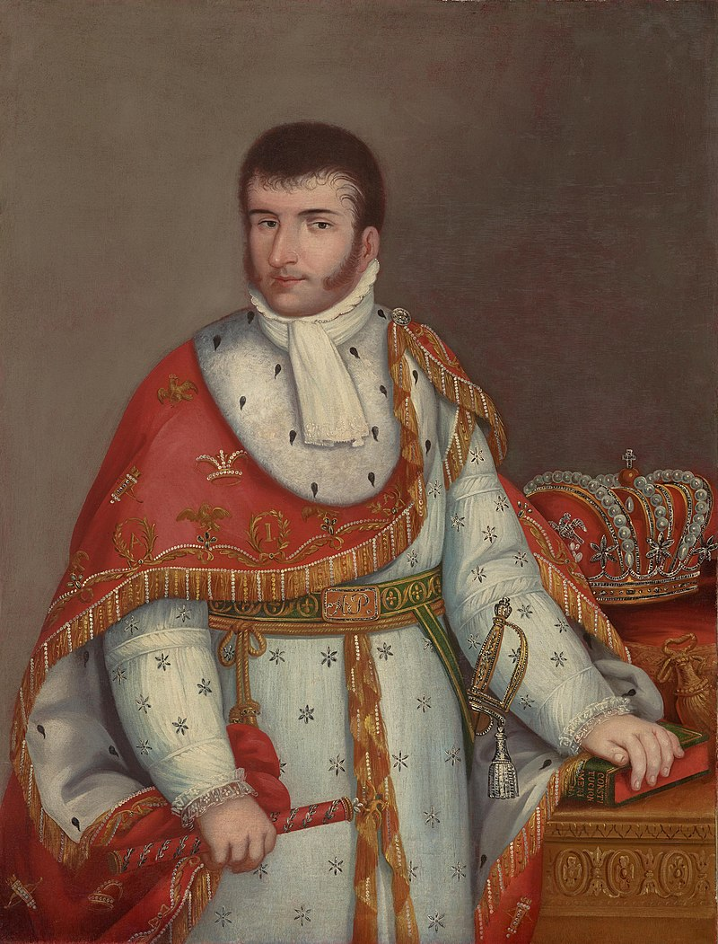
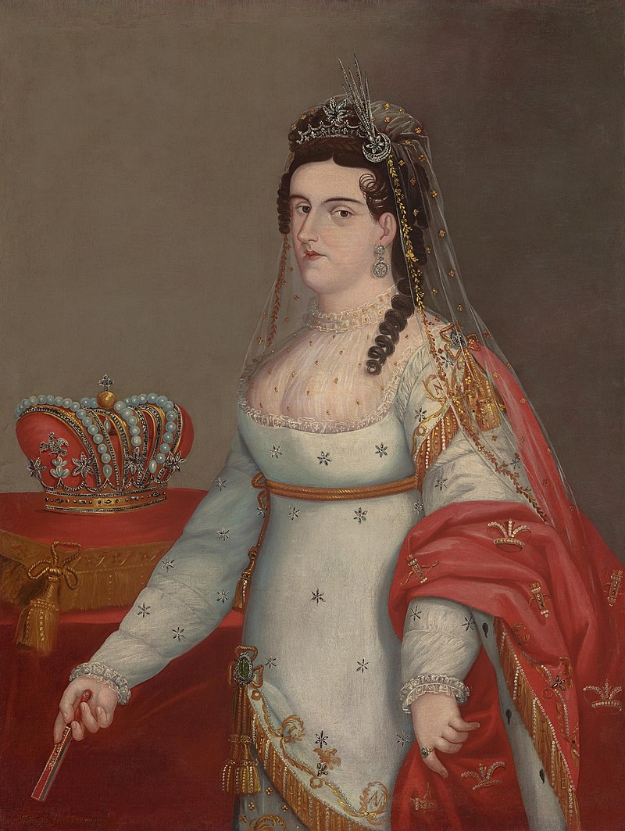
New Mexican Government (s)
Iturbide has himself crown
Augustine 1st and wife
Empress 1823 …Monarch
Catholicism, Social Equality
Federalist Revolt 1824
Iturbide exiled: law written
To be shot if returned
…goes to Italy
Returns 1824 on learning
Spanish about to invade
…..and is shot
Chaotic politics:
75 governments/ 50 years

Slide 35
Mexican Texas

Slide 36
Mexico and Tejas 1824
Mexican government bankrupt, unstable, expecting Spanish to return
Aware of Tejas potential and need income….fast
Area depopulated ..only 2,000 ‘Tejanos’ left (6,000 before war)
Threatened by rising population in American Louisiana (100,000 by 1820’s) and Comanche (Mexico now has no money to pay tribute)
Need people in Texas…and fast ….Spain depopulated by wars
Enter Stephen Austin (‘father of Texas’) with a deal

Slide 37
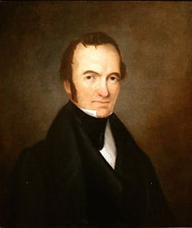
Stephen Austin (1796-1836)
Born Virginia to lead mining family, attends
College in Kentucky learns law…goes into
Business…..bankrupted during panic of 1819
…moves to Arkansas to escape creditors
Father has proposed “Colonisation Contract” with
Spanish but deal collapses with revolution
Stephen Austin goes to Mexico City to
negotiate with ‘King Iturbide

Slide 38
Stephen Austin’s Deal
Mexico gives land grants to Austin sufficient to support settlers
4,000 acres per settlers plus additional land for wives and slaves
Austin to deliver 300 settlers with their families and slaves who must
Become Catholic
Learn Spanish
Pledge loyalty to Mexico
Pay Austin 12 ½ cents per acre
Austin to
Handle Comanche
Ensure new settlers of ‘good character’ and comply with rules

Slide 39
Mexican Texas 1824-1826
Austin deal ‘works’
Each settler met and interviewed personally by Austin
Population Tejas rises to 5,000 300 families & slaves
Austin creates Texas ‘Rangers’ …vigilante groups established to handle ‘Indians”
‘Hispanicised’ Cohalitican Indians exterminated…land converted to cotton plantations
Other tribes herded into reservations
Comanche raids intercepted…stop paying annual Tribute
Change of government in Mexico….new rules
Federalist take power (Irbide shot)
Write Mexican Constitution which abolishes slavery
Invite Austin to Mexico in 1826 to expand contract… under new conditions
,

Slide 40
The New Deal
Tejanos loses power to run themselves
Each Mexican state to establish its own laws
Texas population too small to be ‘state’ absorbed by nearby state of Cahuilla (100,000 plus)
Mexican government builds to collect taxes and reduce smuggling
Slavery to be gradually abolished
Children of slaves free at maturity
No new slaves allowed
Contract doubled… competition from European Catholics
The problem: American settlers want control and slaves

Slide 41
Mexican Texas 1826-1830: Austin’s
Austin introduces “Debt Peonage”….slavery in all but name
Persuades Cahuilla Legislature that contracts made in USA valid in Mexico
All new slaves to be given 99 year employment contract
Children to be looked after till 24 but must then work off cost.. forever
Bribes Cahuilla politicians
Tejas population increases to 30,000 (20,000 Americans, 5,000 Catholic Europeans & Tejanos (Hispanic Texans) ,5,000 slaves,
Violent incidents…….escaped slaves from US returned, tax fort attacked
Cahuilla Government concerned by rumours of slavery & white
persecution of Tejanos …..sends virtuous man to investigate

Slide 42
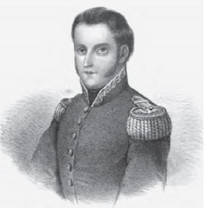
Manual de Mier y Teran (1789-1832)
Creole….mining student fights in war of dependence
Tours Tejas and makes report
Prosperous economically
Americans terrorising Tejanos, Catholic
in name only, many illegal settlers
Slavery rampant… Constitution ignored
Chaos in Mexico Centralist replace Federalists Spanish invade (and repulsed)
Centralists review report, approve
……..issue new “Law of 1830”

Slide 43
Path to War 1830-1836
Centralist government passes “Law of 1830”
No new American (black or white) immigrants (Catholic Europeans only)
Impose taxes on cotton exports, build forts on coast to collect tax
Government in chaos and cannot enforce
Austin and new settlers ignore law
Settlers and slaves pour into Texas
Violent incidents (slaves returned to USA, Mexican fort attacked)
Anglos and Tejanos establish “Consultation” government October 1835
Mexican government collapses …again. Dictator assumes power…invites
Austin to renegotiate Colonisation Contract…again

Slide 44
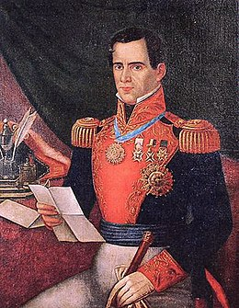
Antonio Lopez de Santa Anna (1794-1876)
Born to wealthy Peninsulare family
Fights for both Royalist and Revolution, then for both Federalists and Centralists!
Dominates Mexican politics till
1860’s .Leads 5 coups to take power…
Unsurpassed in venality, cruelty
duplicity….and……charisma

Slide 45
Negotiation collapse
Austin ‘requests:”
Tejas to be a separate State
Slavery and American immigration allowed
New Texas Constitution
Promises loyalty to Mexico
Santa Anna response
Demands payment to accept
Delays response
Departs with army to crush Federalist revolts across Mexico
Austin gives up and returns to Convention
Convention declares alliance with Federalists and joins revolts
Santa Anna crushes revolts (mass executions)….declares Austin and Convention traitors and leads army North to execute them all

Slide 46
Intermission

Slide 47
Texas War of Independence

Slide 48
Sam Houston (1793-1863)
Born Virginia, family moved to Tennessee self taught, studies classics Leaves home at 16 to live with Cherokee
Sam Houston in 1850
Joins Jackson army.. wounded battle of
Horseshoe Bend…becomes Congressman
then Governor..marries well secures plantation and slaves….divorced
Re joins Cherokee becomes their agent to negotiate removal with Jackson
Accused of fraud, beats Congressman with cane
Reprimanded…fights corruption
Advised to “start again”…..and join Texas
Consultation…..elected Head of Texas Army

Slide 49
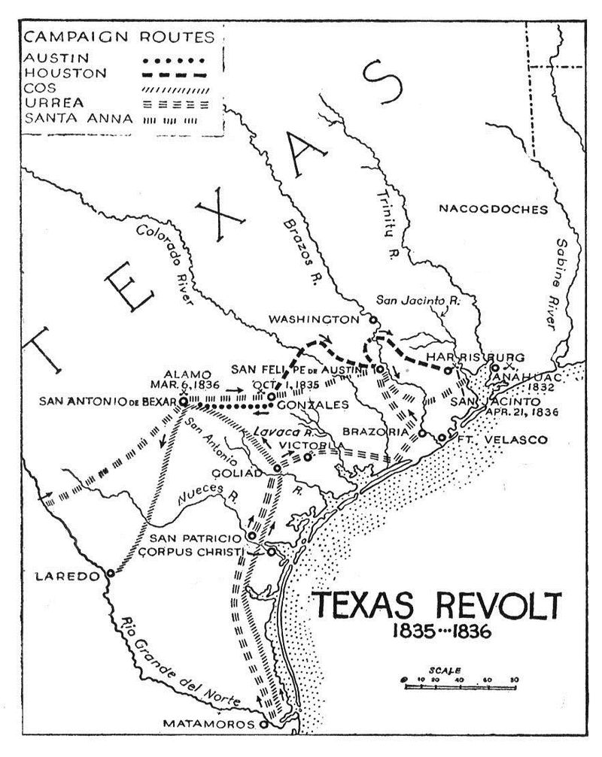
Texas Invaded February 1836
Houston assembles
Army…do not expect
Invasion…joint army of
Tejanos & Texans….
..debate Independence &
…don’t expect invasion
…ask for help from USA
Volunteers
From USA
Consultation Houston
500+
Alamo
200
Send troops to Alamo & Goliad plan to raid Mexican coast
Goliad
400
4,000
Santa Ann leads north army
Surrounds Alamo Feb 1836
2,000
Mexican
Armies

Slide 50
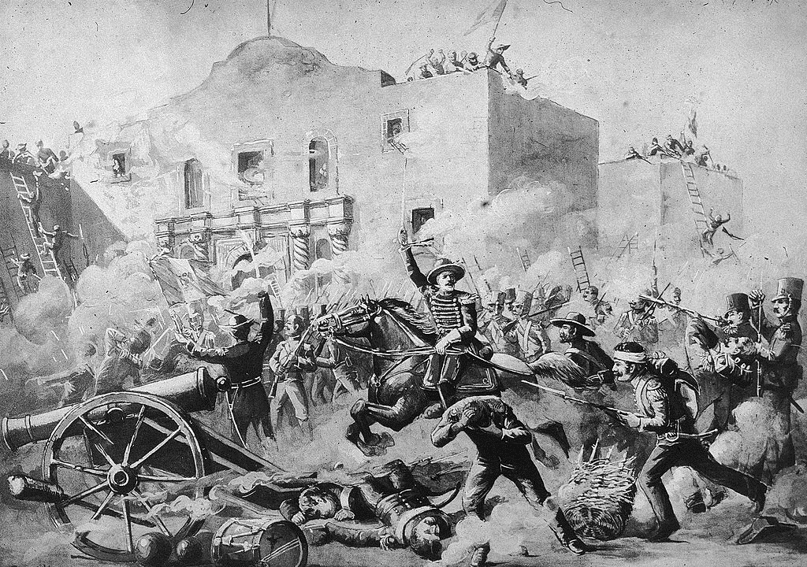
Battle of the Alamo
Joint Commanders
Jim Bowie, W Travis ignore orders to leave …expect reinforcements
Davy Crocket and 20
Volunteers show up…more expected
Santa Anna does not wait & orders attack
Mexicans lose 400-600
All 187 defenders killed
except cook and slave

Slide 51
Alamo Myths (John Wayne 1960)
Defenders fighting for ‘freedom’ and independence
Not true… fighting for Federalist Mexico and retain slavery
Defenders knew they were going to die
Probably not….expected reinforcements
Defenders all white heroes
20 Tejanos included in killed
Mexicans barbaric….custom of time to kill all defenders if no surrender
Dave Crocket died fighting to the last
….(letter validated found From Mexican officer), surrendered with 6 others and shot

Slide 52
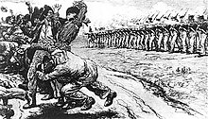
Goliad
Massacre at Goliad
American troops & Goliad
Attempt raid to Mexico
Intercepted by southern
Mexican army…fighting
Retreat back to Goliad
Americans surrounded &
surrender ..on terms
Santa Anna overrules “term”
orders their execution
Mexicans march unsuspecting Americans out of fort…line up….300 shot..30 escape

Slide 53
Aftermath
Texas Consultation declares Independence (4 days after fall of Alamo
News of battle and massacre at Goliad creates panic
American settlers and Tejano flee east
Houston retreats east to forest, army grows to 1,000
Santa Ana divides army again to prevent escape
Makes camp in open field….tall grass April rain
Wants army to rest …and (according to legend) time alone with Emily
Worth (African American woman) …”Yellow Rose of Texas”

Slide 54
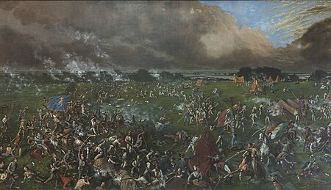
Battle of San Jacinto April 1836
Houston surprise attacks
Resting Mexican army
“Remember the Alamo”
Mexican army annihilated
700 dead, 500 captured
…many executed. 9 Texans killed…Houston wounded,
Santa Anna captured

Slide 55
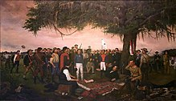
‘Treaty of Velasco”
Sana Anna captured. Dressed
as soldier…President & Leader
Houston persuades Santa Anna
to ‘sign’ Treaty of Velasco
(or get shot) grant ‘Texas’ independence.
Santa Anna ‘agrees’ to get Mexican
Congress to ‘approve’ treaty if
Released. Sent to Washington to
Meet President Jackson
Santa Anna returns to Mexico, repudiates treaty and overthrown
…goes into exile. With gov funds,

Slide 56
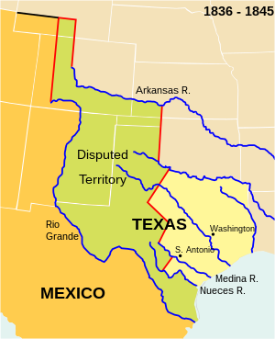
Texas Republic 1836
Sam Houston
“Texas”
“Texas” ‘agreed’ at Velasco
Triple size of Mexican Tejas
Mexican/Spanish
Tejas
New Mexican government
Rejects treaty. Spanish invasion prevents war
Santa Anna recalled from exile
Defeats Spanish, wants revenge
Sam Houston voted President of Texas. Holds vote: 97% of Texans vote to join USA

Slide 57
Sam Houston & Texas Republic 1836-1838
Imposes austerity Budget…Texas close to bankruptcy
cuts army, government..
Imposed Property Tax on Land & Slaves…and personal property ….watches, carriages,
Seeks peace with Indians,
Attempts good relations Anglos and Tejano
Agrees to allow Cherokee to settle in Texas…gives chief his hat as token of trust
Resumes tribute payments to Comanche
Crushes Mexican inspired revolt by Cherokee and Tejanos…and forgives
Seeks annexation with new US President …rejected: fear of war and slavery issue

Slide 58
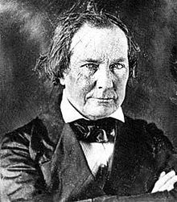
Mirabeau Leemar (1798-1859)
Georgian born plantation family lawyer,
romantic (and appalling) poet, and
…White Supremacist
Moves to Texas. Joins war, hero at
San Jacinto, elected VP to Houston
…partnership of opposites
Elected Vice President….opposes
Houston policy re Indians & Tejanos,
Elected President 1838 when Sam Houston
Term retires….change in policies…

Slide 59
Texas Republic 1838-1841
Population rises to 100,000 as Settlers and slaves move into state
…many debtors escaping ‘Panic of 1837” in US
Leemar invests in public schools, reduces property taxes, increases tariffs
War with Mexico.
support rebels,
creates navy to attack Yucatan
Sends army of 300 to invade New Mexico…army defeated and captured
Indian Removal Policy: Cherokee (Houston’s tribe) forcibly evicted, chief
killed. Hat sent to Sam Houston…..
Launches war with Comanche…

Slide 60
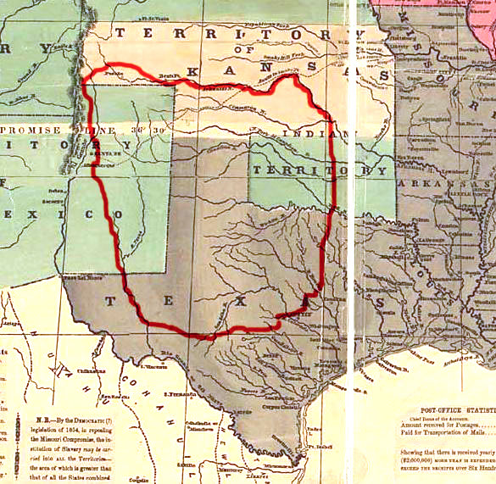
Comanche
Dominate lower Plains since
1750’s..dominate/exterminate
Rival tribes…Apache to
Mountains & North Mexico
“Comancheria Empire”
35,000-50,000 by 1830’s
…multiple bands
…annual Council
Policy of extermination
Or enslavement vs other
Texas Indian tribes…join
Texans to fight them

Slide 61
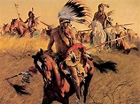
Comanche Raiding Parties
Bands of warriors up
500 strong terrorised Texas and Northern Mexico …culture of buffalo hunting and raiding ...cattle. Carbohydrates, slaves. Manhood
Prisoners ritually tortured
& mutilated…family affair those not screaming released, children adopted
Leemar forms 800 strong ‘Texas Rangers’ destroy
Them….

Slide 62
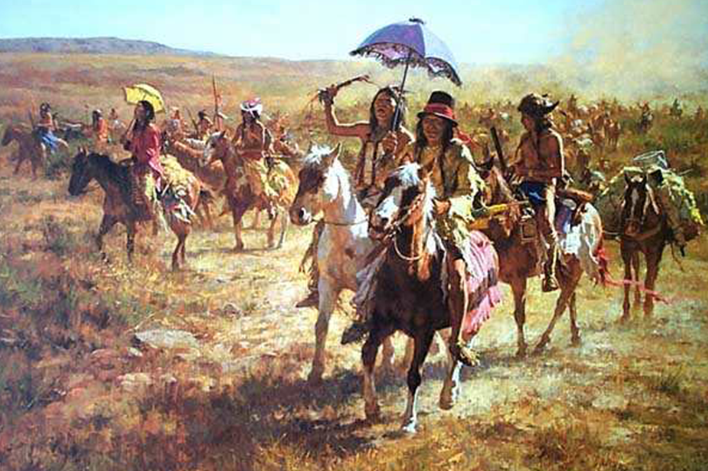
The Great Raid 1840
Comanche raids intercepted
By Rangers. Raid Comancheria
Comanche offer peace exchange prisoners Peace
20 prisoners returned, many
Mutilated. Texans lock up
Comanche Emissaries.
Gunfight ..most killed.
Comanche seek revenge
500 Comanche capture city and
train carrying clothes…murder
settlers, take captives..

Slide 63
Texas Rangers: Battle of Plum Tree
Texas Rangers & Indian allies attack Comanche in the open
Running gun and lance battle
Comanche lose 80 with 20 captives… Indian allies Kill…and eat captives
Raids stop…..Comanche
Make peace with tribes
And raid Mexico instead

Slide 64
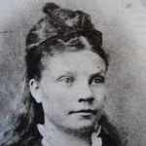
The tale of Rachel Plummer
Moved to Texas with family group of 50.. Settled in
‘Comancheria 1835), pregnant + 1 son
Husband, father most men in fields. Comanche attack
cabins and kill grandparents take Rachel and son captive..
Son becomes Comanche…does not see him again
About treatment: “anyone who said that a good woman died before being violated had not been forced to run naked tied by a rope to a horse for a day or two in the sun, and further”
Adapts to life, kills woman made her master
…Comanche agree she was
Father searches for her and buys her back from
Comanche… reunited with husband, 2 years late
r…writes memoir ….dies

Slide 65
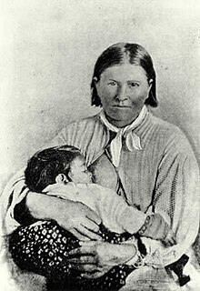
Cynthia Anne Parker (1827-1871)
Captured as 10 year old child
By Comanche, parents killed
Lived with Comanche 24 years
Married. Given name ‘Naduah;
…someone found
‘Rescued” with baby son by Texas
Rangers in 1871…who kill all her
Comanche Family
Forcibly united with extended family
Unable to adapt ….starves herself to
death

Slide 66
Sam Houston 2nd Presidency 1842-1845
Retains Ranger and Comanche war policy…provides weapons to Comanche….as long as they raid Mexico only
Santa Anna launches “Revenge” raids vs Texas 1842
Captures San Antonio
Army defeated by Texans
Returns to Mexico….massacres pursuing Texan company
Houston sends army of 1,000 to retaliate…Mior Expedition

Slide 67
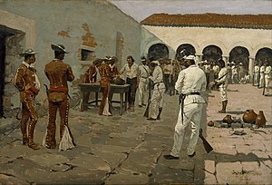
Mior Expedition 1843
Black Bean Incident
Texan Army of 1,000 seizes port
but Sam Houston orders return
400 refuse to go…want more loot
Mexican army arrives, Texans
Surrender sent to march to Mexico City
200 escape….recaptured. Sana Anna
Orders them all shot
Mexican general chooses to kill
1 in 10…black and white beans
selected. Black bean takers shot

Slide 68
Aftermath
Houston and his successor recognise Texas must join USA
Negotiations resume 1845.
The US has changed and more receptive
…gospel of “Manifest Destiny” dominates US politic
….US will want more than Texas
To be continued at next talk

